Slide 1
Bank Analytics Project
Domain : Finance
Pranjal Gusain- pranjalgusain00@gmail.com

Slide 2
PROJECT OVERVIEW
01
02
03
Work Done
TARGET
Tools Used
Created different dashboards on Bank loan of customers.
Analysing insights using KPI’s
Excel, Power BI, Tableau and SQL

Slide 3
PROJECT SUMMARY
Objective :
The objective of the project is to comprehensively analyze bank loan data by tracking Key performance indicators (KPI’s) such as Year wise loan amount, Grade & subgrade wise revolving balance, Total payment for Verified vs Not verified status, State wise and last credit pull date wise loan stats and Home ownership vs last payment date status.
Scope :
Data Collection and Analysis
Predictive Modeling
Designing Bank Strategies

Slide 4
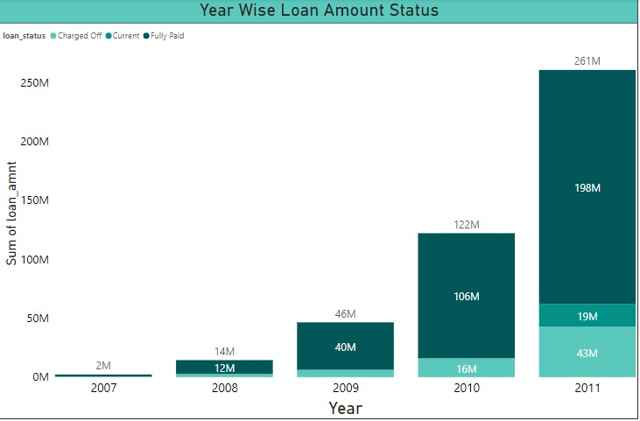
KPI 1 - Year wise loan amount stats
Highest percentage increased in loan amount is 600% as a result of less outstanding between the year 2007 & 2008.
Lowest percentage increased in loan amount is 114% as a result of huge outstanding between the year 2010 & 2011.
Conclusion :
Bank can expect 5.74% of increase in loan amount in the year 2012 and 18% for the year 2014.
To resolve any payment errors bank can take a step of chasing up on missing or overdue payments from clients and seizing assets.

Slide 5
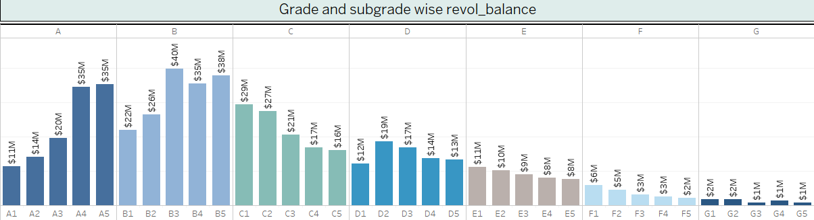
KPI 2 – Grade & subgrade wise revolving balance
Grade B has the highest sum of revolving balance at 161M.
Grade G has the lowest sum of revolving balance at 7M.
The data may reflect creditworthiness, with higher balances in the earlier categories suggesting larger available credit.
There is significant variation in the sum of “revolving balance" within each category, indicating differing levels of revolving credit usage.

Slide 6
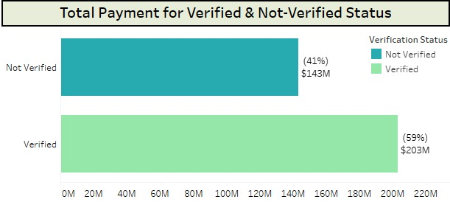
KPI 3 - Total payment for Verified vs Not verified status
Verified loans have undergone stricter documentation and verification processes and are associated with higher total payments.
Conclusion :
Bank should involve refining verification procedures, targeting specific customer segments and checking customers financial stability for lesser risk and more assurance of loan repayment.
Not verified loans have higher risk of assurance of repayment of loans and have higher interest rate.

Slide 7
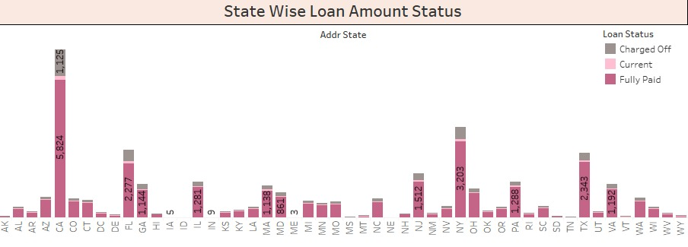
KPI 4 – State wise & last credit pull date wise loan status
There are notable differences in loan status distributions across states. States with stronger economies, such as California (CA), New York (NY), and Texas (TX), tend to have higher counts across all loan statuses.

Slide 8
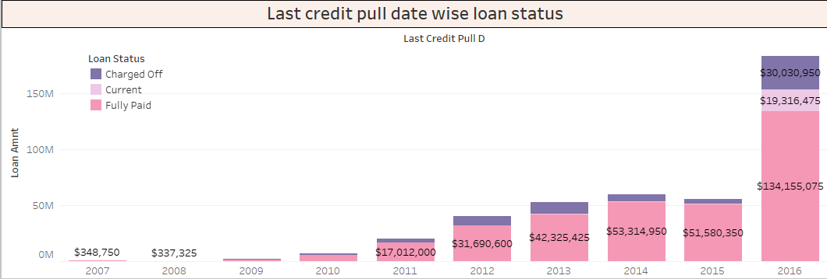
There is a substantial increase in the total loan amount over the years, with significant growth observed particularly from 2012 onwards.
The "Charged Off" category indicate loans that have been declared as losses. The total amount of charged-off loans increases over the years, peaking in 2016.
The "Current loan" category refers to the loans that are currently active and being repaid by the borrowers. The amounts in this category are relatively stable across the years, with a slight increase observed in later years.
The "Fully paid“ category represents loans that have been fully repaid by the borrowers. The amounts under this category show a consistent upward trend over the years, indicating an increase in successful loan repayments.

Slide 9
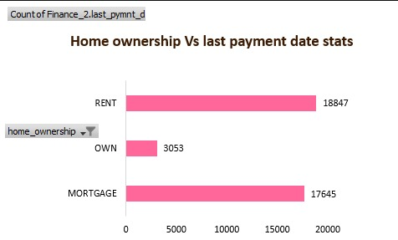
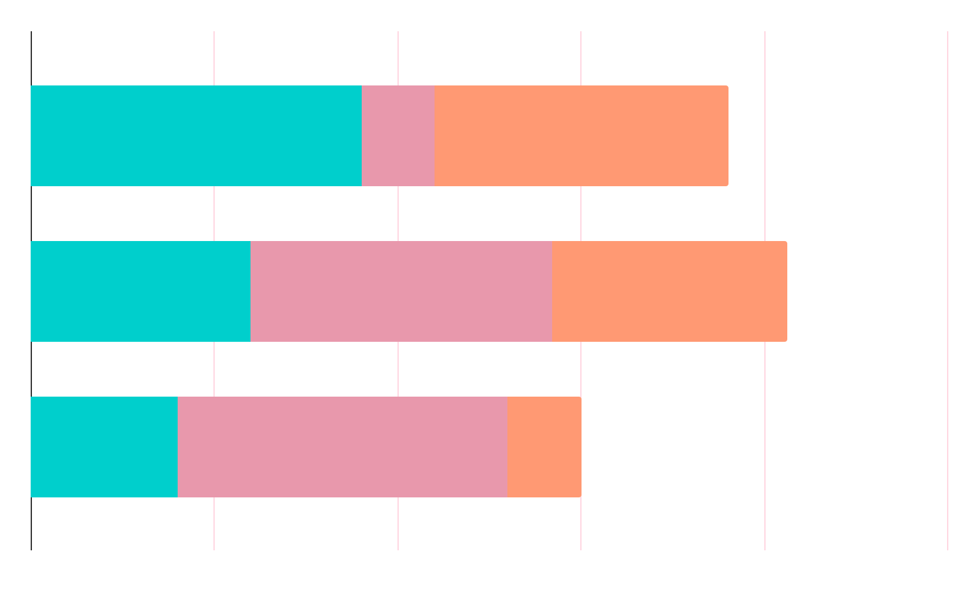
KPI 5 – Home ownership vs last payment date stats
Rent category represents the first largest group, it indicates that a significant portion of individuals are renting their homes rather than owning.
Mortgage category represents the second largest group, it indicates substantial no. of individuals are homeowners with active mortgage loans.
Own category is the smallest among the three categories which indicates that least no. of individuals have more flexibility to manage their finances.
Conclusion :
Renters prioritize on time payments to maintain their rental agreements and avoid potential consequences.
Homeowners exhibit the highest level of financial stability and commitment to on time payments.
Mortgage holders committed to their housing payments and may face higher financial pressure.

Slide 10
Bank need to understand the demographics of customers taking loans, such as age, income level, occupation, and credit score. This information can help the bank design targeted loan products and marketing strategies. By analyzing the most common purposes for which customers are taking loans like home purchase, car loan, education, personal use etc. This helps to understand customer needs, accordingly bank can offer the loan products. By examine the range of interest rates and loan terms offered to customers, bank can provide insights into the competitiveness of the loan offerings and how they compare with other financial institutions.
Conclusion

Slide 11
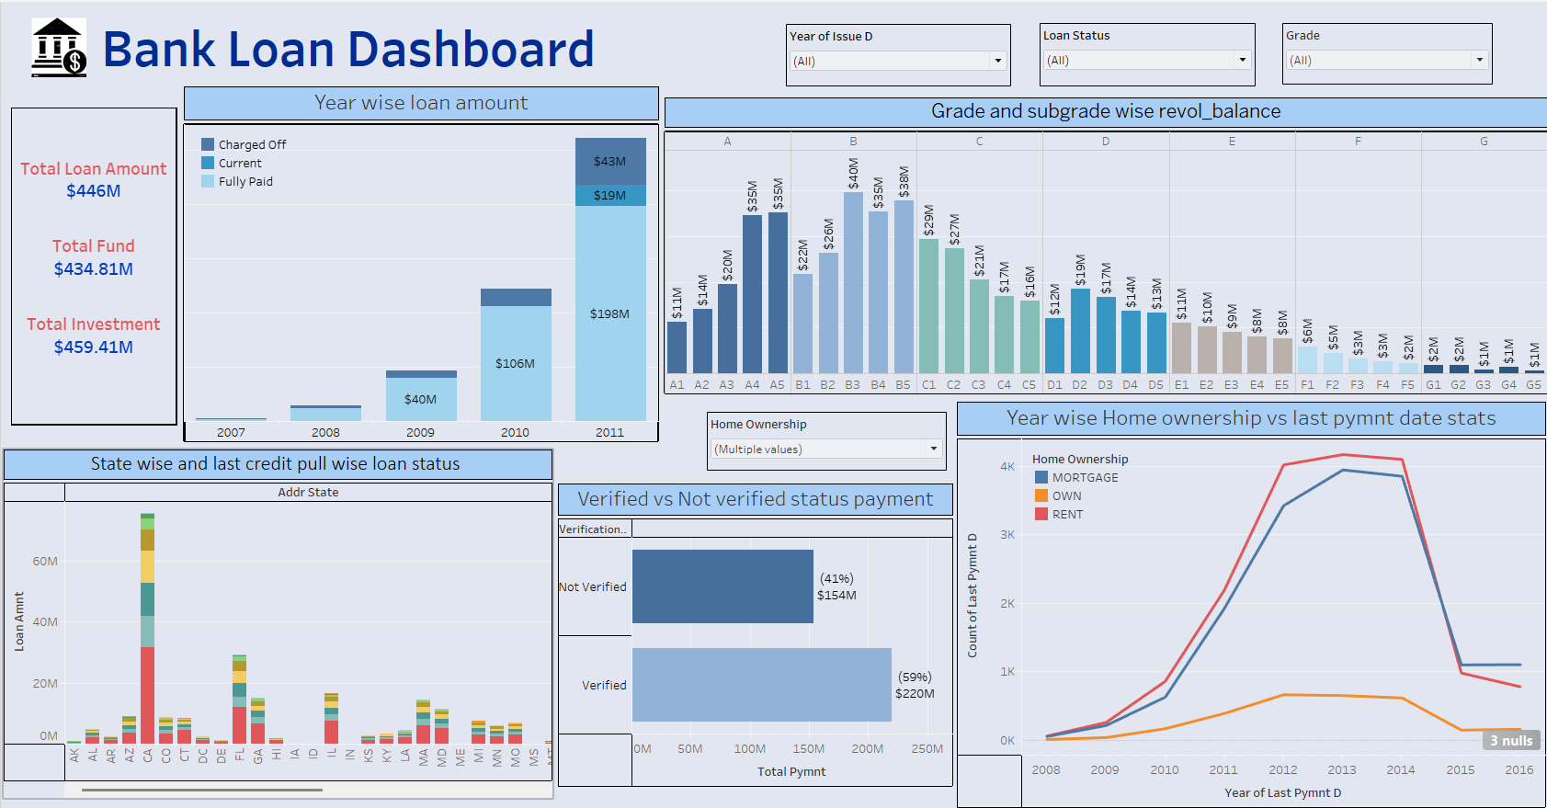
Tableau Dashboard

Slide 12
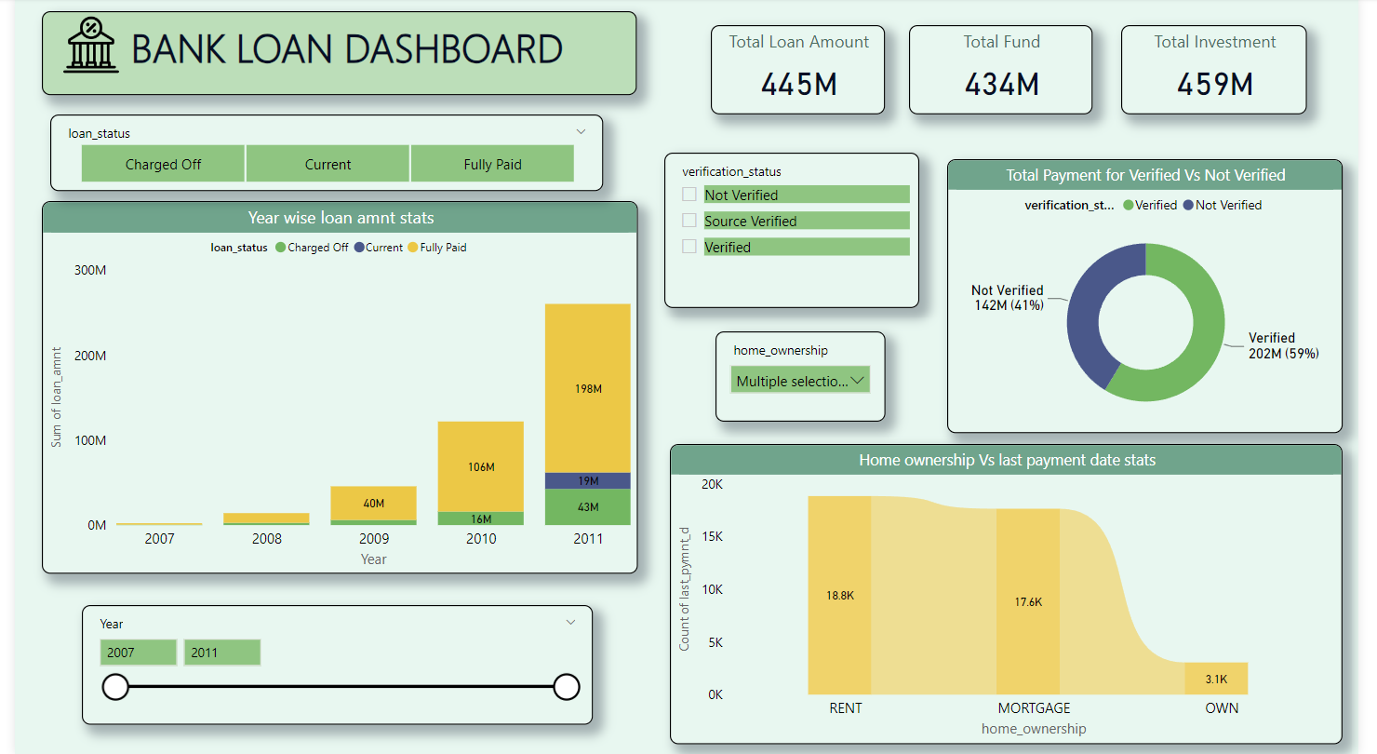
Power BI Dashboard (Page-1)

Slide 13
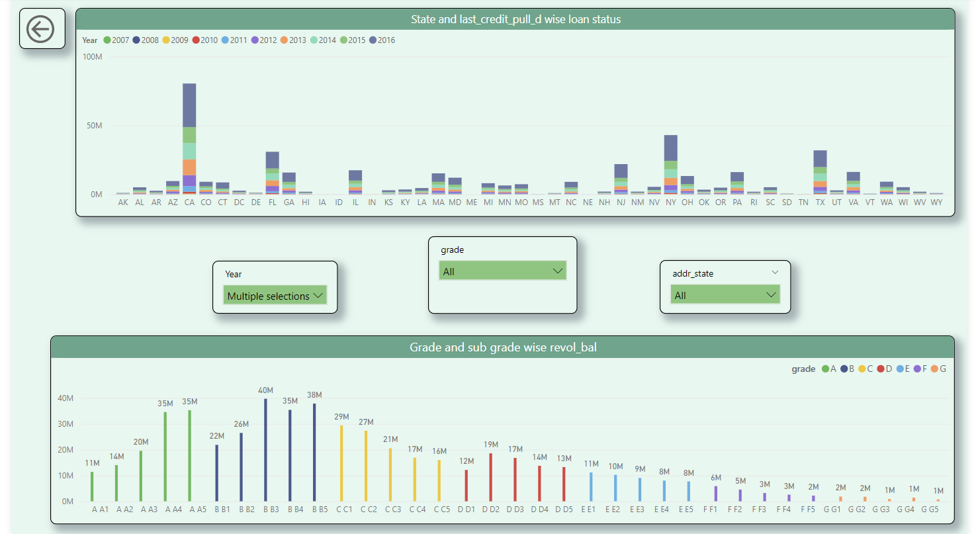
Page-2

Slide 14
THANKYOU

